Slide 1
Deep Learning-Based Rotor Temperature Estimation for Rare-Earth-Free Motors
Farzaneh Tatari, PhD | Mohsen Mirza Aligoudarzi
Farzaneh.Tatari@drivesystemdesign.com, Mohsen.Aligoudarzi@drivesystemdesign.com
Drive System Design Inc., Farmington Hills, MI, US

Slide 2
Outline
Virtual sensor modeling - Rotor temperature estimation
  Why E-motor thermal modeling?
Methods for E-motor thermal modeling
Advantages of data-driven thermal modeling
Electrically Excited Synchronous Motor (EESM): Rare-Earth-Free
Inputs and outputs for Deep learning thermal model
Recurrent Neural Networks: GRU & LSTM
Model Architecture & Training Setup
Model Evaluation
Conclusions
1

Slide 3

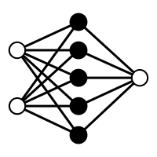
Virtual sensor modeling - Rotor temperature estimation
A virtual sensor replicates the function of a physical sensor by leveraging data from other measurements to estimate the quantity of interest.
Why virtual sensors?
Physical sensors may be:
  Expensive
  Slow
  Noisy
  Unreliable
  Not feasible
  Unmanufacturable
  Degrading over time
  Requiring redundancy
  etc.
System measurements
Estimated quantity
Virtual Sensor
(Observer)
System & E-motor measurements
Rotor temperature
AI
2

Slide 4
Why E-motor temperature modeling matters?
Guaranteeing E-motor safety and reliability
Improving the performance of the motor cooling system and minimizing losses
Improving overall system performance
3

Slide 5
Methods for E-motor thermal modeling
1. Using sensors
Physics-based: discretize motor into thermal nodes (stator, rotor, bearings)
Complex and computationally heavy
3. Indirect / Observer-Based
4. LPTN direct thermal modeling
Exploit temperature-dependent electrical parameters
High Costs of sensors
2. CFD and FE
Not appropriate for real-time temperature estimation
5. Supervised machine learning
Limited physical interpretability
Difficult to install because of mechanical constraints (wiring complexity & durability concerns)
Sensitive to parameter uncertainty
Increases machine losses & Severe estimation errors
White-box (geometry/material) or gray-box (physics + fitted params)
Computationally efficient but parameter identification is labor-intensive
Require substantial training data
Require periodic recalibration for aging effects
4

Slide 6
Advantages of data-driven thermal modeling
1. Generalization
ML thermal models are generalizable to different motor types and application scenarios.
2. Automation
ML models can be automated.
3. Bypassing uncertainty
ML models bypass modeling uncertainty well, since they are not limited to physical assumptions.
4.Simplicity for real-time estimation
Unlike CFD and FE, machine learning models can be executed in real-time.
5. Accuracy
Despite indirect thermal modeling methods, ML thermal modeling does not suffer from severe estimation errors.
LPTNs are more specific to a particular motor type and require motor design and material information.
This saves time and effort in the modeling process.
5

Slide 7
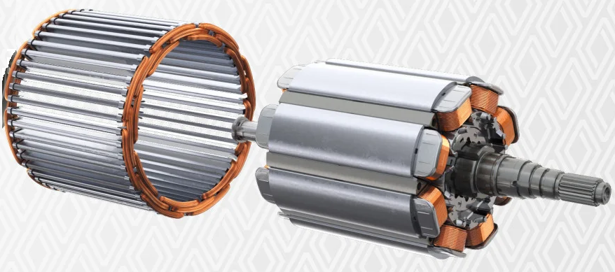
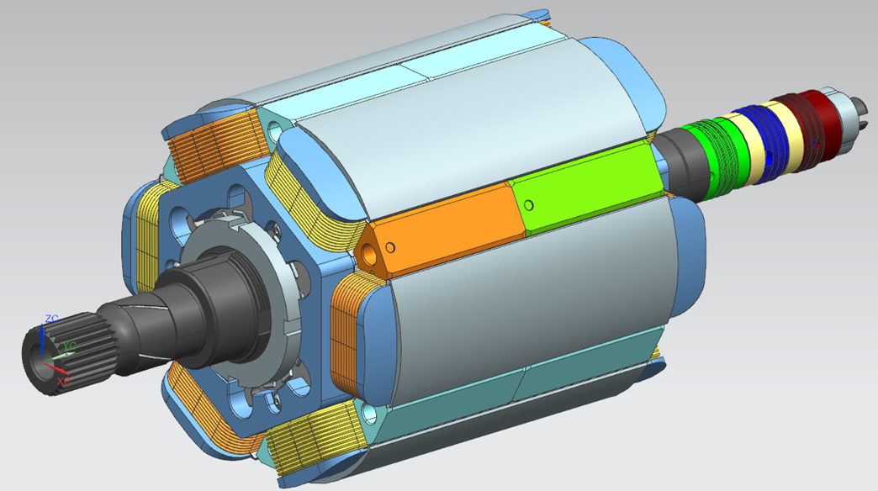
Electrically Excited Synchronous Motor (EESM):
Rare-Earth-Free Architecture
Thermal Modeling Challenge for EESMs
Rotor flux generated by electrically excited copper windings
Field excitation introduces distinct rotor thermal dynamics vs. PMSMs
This work: first RNN-based (GRU/LSTM) thermal virtual sensor for an EESM
EESM specifications
3-phase motor
                190 kW
                containing 54 slots and 6-poles
                Sampled at 10 Hz over multiple test days
Fig. 1. Electrically Excited Synchronous Motor (EESM)
6

Slide 8
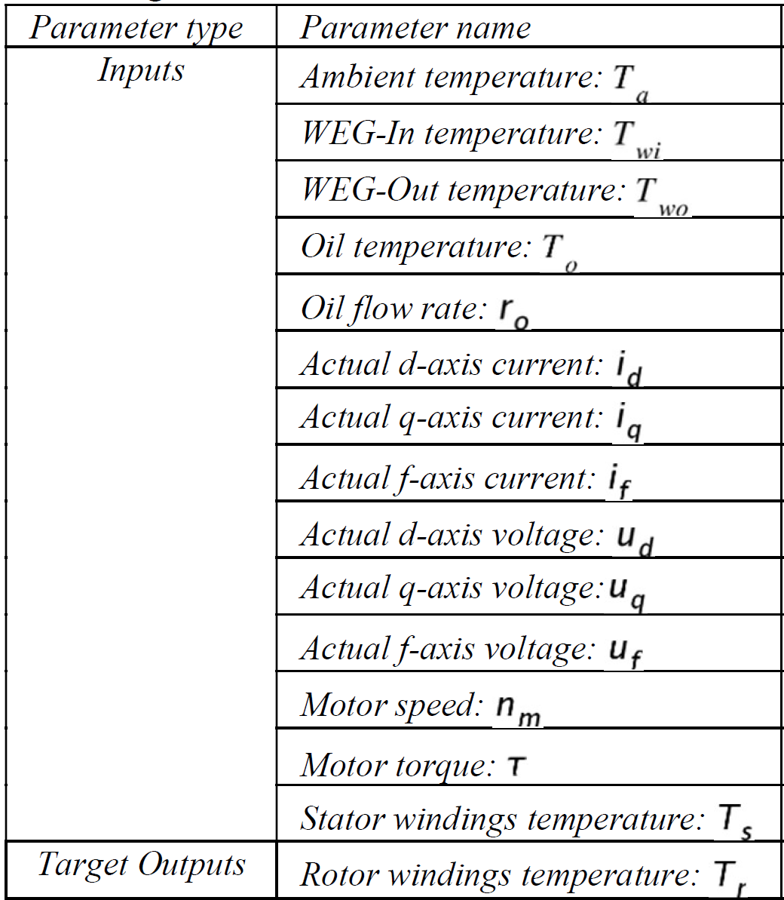
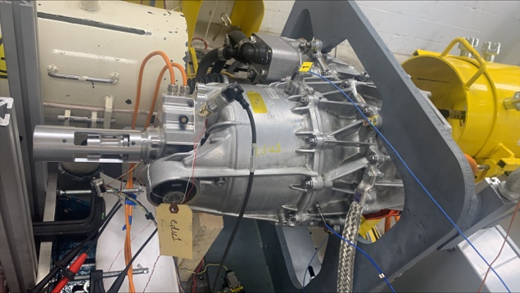
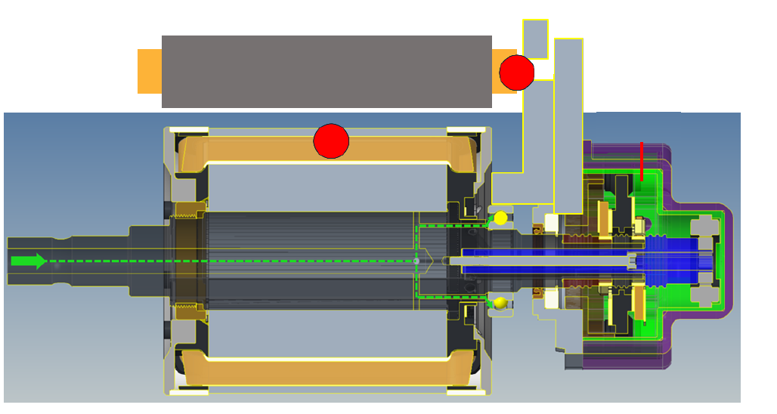
Data Collection: Inputs and outputs for EESM Deep learning thermal model
Collecting all inputs and outputs using different measurement cycles
Initial data analysis and filtering
Dataset
240,000+ multi-dimensional samples
Torque: -150 to 200 Nm
Speed: -1,000 to 8,000 rpm
No additional hardware required — all inputs available from ECU
Table 1: Default inputs and output of the deep learning thermal model for EESM
Fig. 3. EESM rotor and stator temperature sensors’ positions depicted with red circles.
Fig. 2: EESM in the test bench.
7

Slide 9
Supervised Learning Methods
Table 2: Supervised Learning Methods
Type | Classic machine learning | Deep Learning
 |  | Feedforward neural network (FNN) | Recurrent neural network (RNN)
Description | Learn patterns from data; often require feature engineering | Data flows in one direction through layers | Designed for sequential data, captures temporal dependencies
Algorithms | OLS, Decision Trees, Random Forests, SVMs, etc. | FNN (also known as FFN) | Long-Short Term Memory (LSTM); Gated Recurrent Unit (GRU)
Recurrent Neural Networks: GRU & LSTM
Recurrent Neural Networks (RNNs)
Maintain a hidden state that carries information about past — ideal for thermal time-series
Gating mechanisms that regulate information flow across time steps
Enabling stable gradient propagation
Improved learning of long-range temporal dependencies.
        LSTM (Long Short-Term Memory)
        GRU (Gated Recurrent Unit)
8

Slide 10
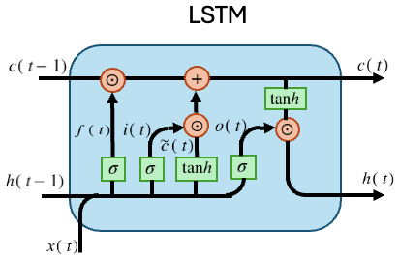
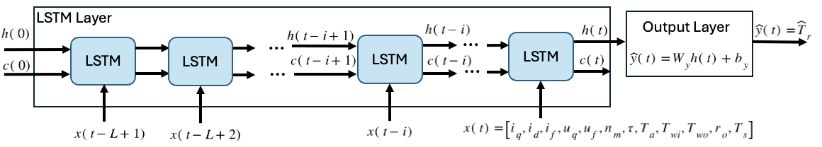

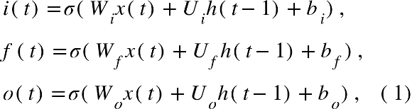

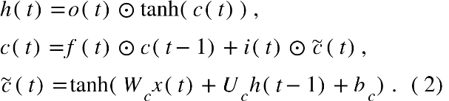
LSTM (Long Short-Term Memory)
Input layer
$x\left(t\right)$:$x\left(t−L+1\right)$
𝑥(𝑡):𝑥(𝑡−𝐿+1)
LSTM Layer
$$c\left(t\right),h\left(t\right)$$
𝑐(𝑡),ℎ(𝑡)
Output Layer
$$\hat{y}\left(t\right)=W_{y}h\left(t\right)+b_{y}$$
𝑦 ̂(𝑡)=𝑊_𝑦 ℎ(𝑡)+𝑏_𝑦
Fig. 5: LSTM computational structure
Fig. 4: LSTM layer and output layer
Three gates
        Input
        Forget
        Output
Input
hidden state
Hidden state
cell state for long-range memory
candidate cell
9
Notes:
The LSTM network processes a sequence of motor measurements x(t) with sequence length of L and maintains internal hidden and cell states (h(t),c(t)) that capture the temporal dynamics of the system.

Slide 11
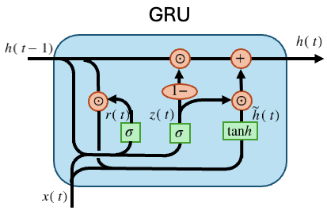
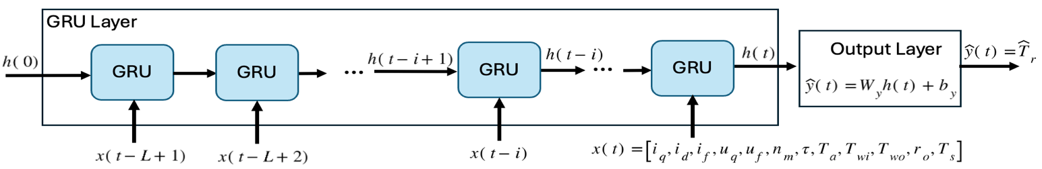



GRU (Gated Recurrent Unit)
Input layer
$x\left(t\right)$:$x\left(t−L+1\right)$
𝑥(𝑡):𝑥(𝑡−𝐿+1)
GRU Layer
$$h\left(t\right)$$
ℎ(𝑡)
Output Layer
$$\hat{y}\left(t\right)=W_{y}h\left(t\right)+b_{y}$$
𝑦 ̂(𝑡)=𝑊_𝑦 ℎ(𝑡)+𝑏_𝑦
Fig. 6: GRU computational structure
Fig. 7: GRU layer and output layer
Gates
Update
Reset
Candidate hidden state
Hidden state
The recurrent hidden and cell states are initialized to zero at the beginning of every sequence.
Weight Update Mechanism for LSTM and GRU: Gradient-based optimization
loss function in regression problems.
N=8 the size of Mini Batch in the training process.
Weight update mechanism: backpropagation through time (BPTT), combined with a numerical optimizer (Adam optimizer).
10
Notes:
The update gate z(t) interpolates between retaining the previous hidden state and adopting the new candidate state. The reset gate r(t) controls how much past information is used to compute the candidate state.
The recurrent hidden and cell states are initialized to zero at the beginning of every sequence, allowing the network to learn temporal dependencies within each window while preventing information leakage across different training samples.

Slide 12
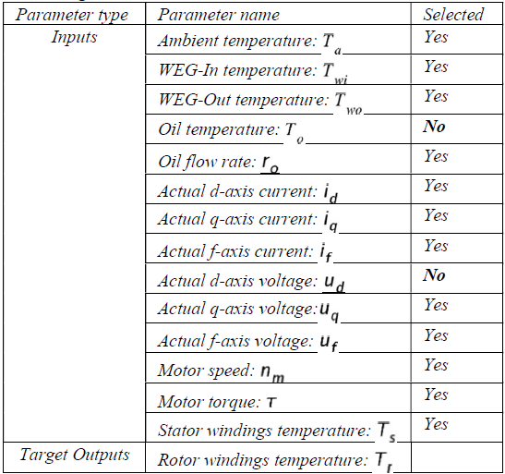
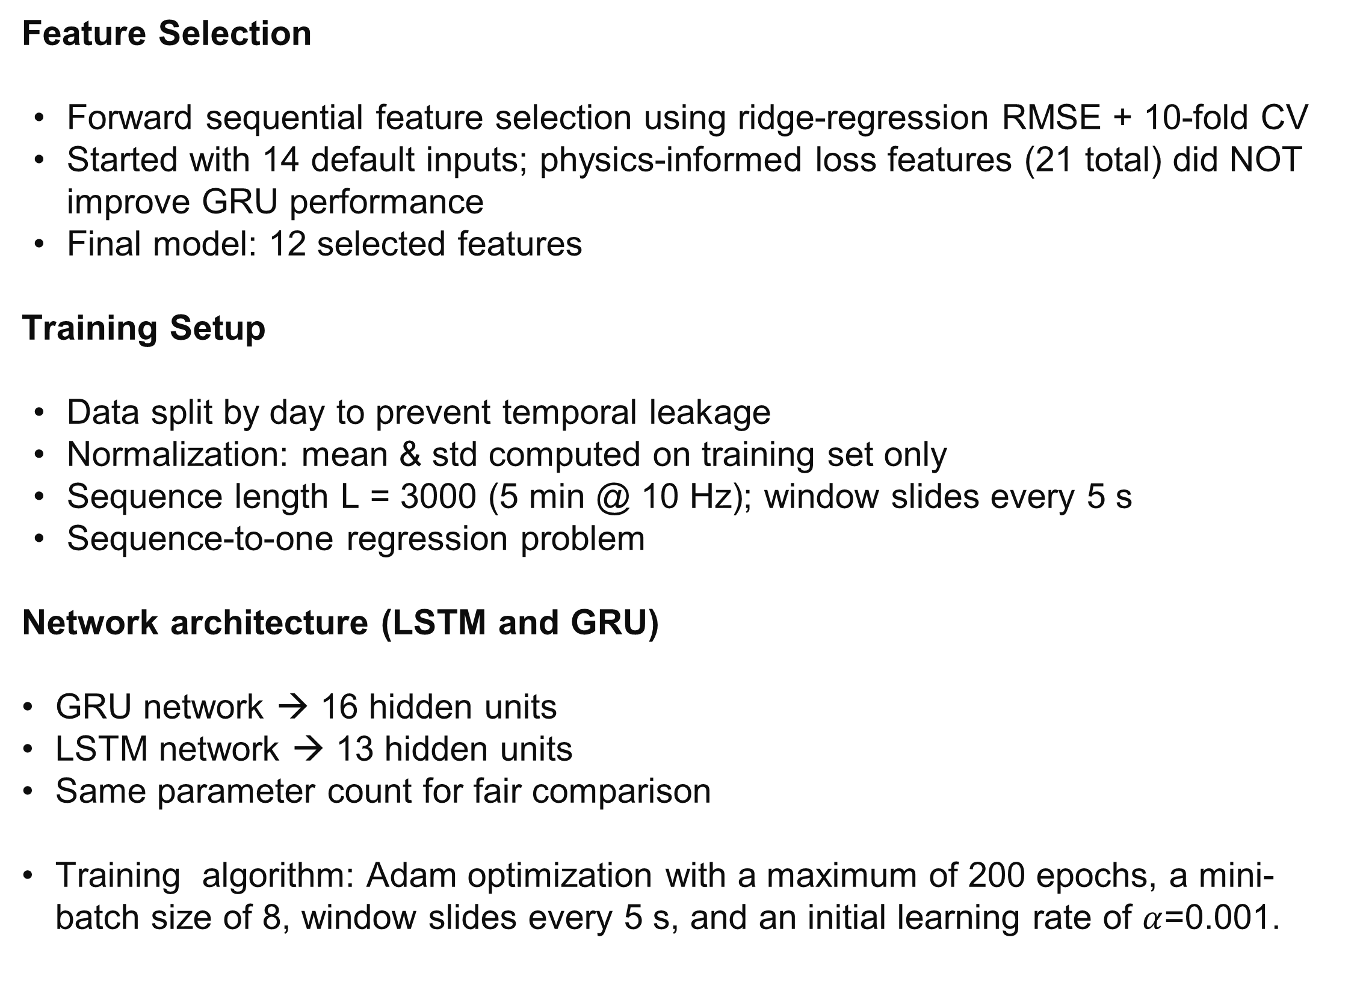
Model Architecture & Training Setup
Feature Selection
Forward sequential feature selection using ridge-regression RMSE + 10-fold CV
Started with 14 default inputs; physics-informed loss features (21 total) did NOT improve GRU performance
Final model: 12 selected features
Training Setup
Data split by day to prevent temporal leakage
Normalization: mean & std computed on training set only
Sequence length L = 3000 (5 min @ 10 Hz); window slides every 5 s
Sequence-to-one regression problem
Network architecture (LSTM and GRU)
        GRU network → 16 hidden units
        LSTM network → 13 hidden units
        Same parameter count for fair comparison
Training algorithm: Adam optimization with a maximum of 200 epochs, a mini-batch size of 8, window slides every 5 s, and an initial learning rate of $α$=0.001.
Table 1: Default inputs and output of the deep learning thermal model for EESM
11

Slide 13
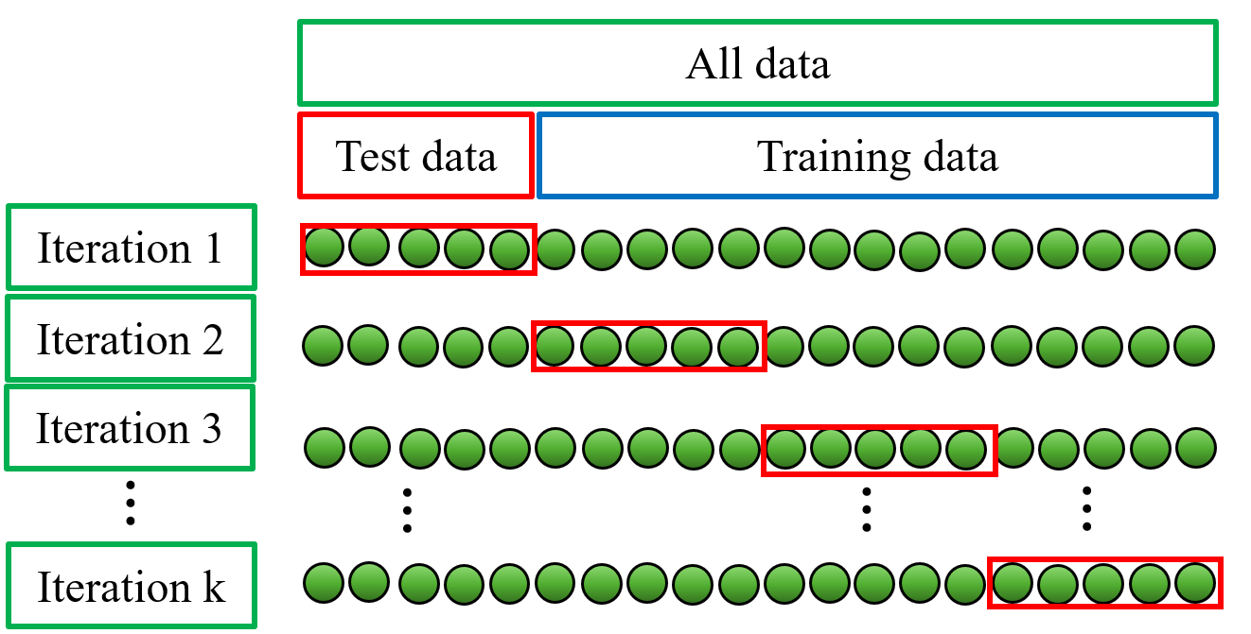
Model Evaluation
Validation Strategy
10-fold cross-validation
Metrics: MSE, MAE, MaxAE on unseen test data
Key Findings
GRU outperforms LSTM across all metrics
Inference latency: GRU ~2.0 ms | LSTM ~1.9 ms per prediction
For GRU and LSTM models, inference was measured using predict with mini-batch size equal to 1. The timing was repeated for all test samples, and the mean and standard deviation were reported.
Table 3: 10-fold cross-validation testing results of GRU and LSTM for EESM rotor thermal modeling
 | GRU rotor thermal model |  |  | LSTM rotor thermal model
10-fold cross-validation | MSE | MAE | MaxAE | MSE | MAE | MaxAE
Error average (°C) | 2.8042 | 2.2632 | 8.5173 | 4.4535 | 3.4273 | 15.1870
Fig. 8. k-fold cross-validation.
Table 4: Comparison of the DL (RNN) results with classic ML (OLS) results [21],
 | OLS [21] | GRU | LSTM
No of inputs | 21 | 12 | 12
MSE | 2.8983 | 2.8042 | 4.4535
MAE | 1.2797 | 2.2632 | 3.4273
MaxAE | 16.7639 | 8.5173 | 15.1870
Data Sequence | 6000 | 3000 | 3000
[21] F. Tatari, D. Trapp, J. Schneider and M. M. Aligoudarzi, "Data-driven Thermal Modeling for Electrically Excited Synchronous Motors - A Supervised Machine Learning Approach," 2024IEEE Transportation Electrification Conference and Expo (ITEC), Chicago, IL, USA, 2024, pp. 1-6.
12

Slide 14
Model Evaluation
Fig. 9. Motor speed, torque, GRU and LSTM rotor temperature estimation for a measurement cycle (test set).
13

Slide 15
Conclusions
Summary
Developed GRU and LSTM recurrent neural networks for online rotor temperature estimation in a 190 kW EESM
GRU achieved lower MSE, MAE, and MaxAE than LSTM with equivalent inference speed (~2 ms)
Validated on experimental data via 10-fold cross-validation across unseen operating conditions
No additional sensors needed — all inputs from existing ECU signals
Implications
Enables reliable thermal protection for rare-earth-free EESM powertrains
Lightweight enough for embedded deployment in motor control units
Data-driven approach eliminates labor-intensive LPTN parameter identification
Future Work
Simulation and test of the GRU thermal model as a part of larger system,
Code Gen and deployment of the GRU thermal model in the E-motor ECU,
Extended field validation across vehicle-level duty cycles,
14

Slide 16

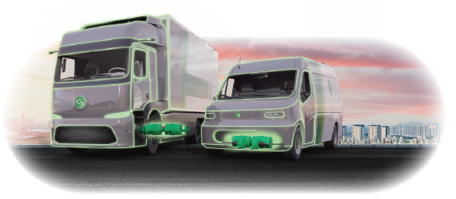

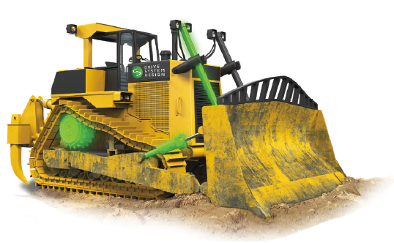
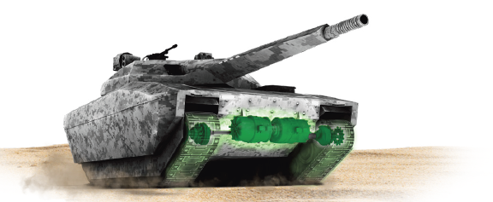
Thank you! Q & A

